Slide 1
Machine Learning
Exercise 2
Regression
Group 18: Hollaus Aymeric, Moulinier Arthur, Chakarov Teodor

Slide 2
First Dataset
For the first dataset we used one called “Brilliant Diamonds” which conveys information about the prices, features, shapes, etc. of diamonds
It can be found under https://www.kaggle.com/datasets/miguelcorraljr/brilliant-diamonds
About 119 000 data entries
The columns are:
Id (number)
Url (object)
Shape (categorical)
Price (float) → target attribute
Carat (float)
Cut (categorical)
Color (categorical)
Clarity (categorical)
Type (categorical)
Date_fetched (datetime)

Slide 3
First Dataset - Pre-Processing
We’ve kept these attributes after/during pre-processing:
Shape (one-hot encoded)
Price
Carat
Color (one-hot encoded)
Clarity (one-hot encoded)
MinMaxScaler() was used since it is a known fact that algorithms converge faster when features are closer to the normal distribution.
One-hot encoded:
Why use it? Because columns that consist of strings are easier to work with if transformed into additional features based on the number of unique values in the categorical feature.
Sklearn MinMaxScaler():
Transforms features by scaling each feature to a given range. Useful since it preserves the shape of the original distribution while scaling it.

Slide 4
Second Dataset
We’ve used one of the same datasets we used for the prior exercise, in this case we picked the New-York City AirBnB dataset
It can be found here https://www.kaggle.com/dgomonov/new-york-city-airbnb-open-data
This data set is tabular data set (like the prior one) which consists of 38277 samples
36872 (uniques) and 18 attributes (columns) of which we have:
8 int
7 objects
3 float

Slide 5
Second Dataset - Pre-Processing
Dropping id column and object columns (hostname, last_review, license)
Imputed the missing values which were in column reviews_per_month
Label encoded neighbourhood_group, neighbourhood, room_type
Fit the data into pipelines with MinMaxScaler()
Imputation:
It preserves all cases by replacing missing data with an estimated value based on other available information
Label encoding:
Each label is assigned a unique int based on alphabetical ordering. Is used to achieve something similar than the one-hot encoder

Slide 6
Third Dataset
This dataset consists of information of FPS values in video games
It can be found here https://www.openml.org/search?type=data&sort=runs&id=42737&status=active
This dataset has quite a lot of attributes, 45 to be exact
CPU and GPU characteristics, whilst the target if the FPS value.
About 425 833 entries

Slide 7
Third Dataset - Pre-Processing
Here we do indeed have missing values
10 attributes with missing values, of which 4 have more than 200 000 missing entries
We decided to drop them to bypass that issue, but please take this into account when looking at our findings and such
The other missing values where handled with the imputation transformer SimpleImputter()
Label encoding applied on the categorical variables GameName and GameSettings.

Slide 8
Train - Test Split
We used sklearn’s train_test_split() function
Common split percentages are:
Train: 80%, Test: 20%
Train: 67%, Test: 33%
Train: 50%, Test: 50%
→ We’ve opted for option one, fairly arbitrary since in most cases none of these three options are better than the others

Slide 9
Cross-Validation
For cross-validation we simply used sklearn’s cross_val_score() function, which simply evaluates a score by cross-validation
For scoring we used R², which is a measure of the goodness of fit of a model used in regression
A score of 1 indicates that the predictions perfectly fit the data
Folds were set to 5; 5-fold cross validation is the default

Slide 10
Gradient Descent Algorithm
Can be used for Ridge Regression and Linear Regression
Ridge Regression specializes in analyzing multiple regression data which has multicollinearity traits and also has regularization therm L2 which has penalty in the Loss function. For L2 has squared magnitude.
Multicollinearity occurs when there are high correlations between more than two predicted variables
Gradient Descent is an optimization algorithm that basically tells us the next position we need to “go to”, which has the steepest descent

Slide 11
Gradient Descent Algorithm in Practice 1
Initialize weights randomly
Calculate the gradients, where the value of the gradients depends on the inputs, current model parameters and the cost function
Update the weights
Repeat till the cost function stops reducing or termination criteria is met

Slide 12
Gradient Descent Algorithm in Practice 2
Hyperparameters (values used to control the learning process) and their values:
We sticked with the defaults:
Learning rate = 0.1 aka. 10% of the estimated weight error each time the weights are updated
Iterations (our termination criteria) = 1000, self explanatory
Alpha = 0.1, this parameter controls the degree of sparsity of the estimated coefficients

Slide 13
Gradient Descent vs. others
Test Data
Diamonds - Hyper-params - alpha = 1, learning rate = 0.1 (custom linear regression is our implementation)
Algorithm | MSE | MAE
Ridge Regression | 2355.62 | 1630.98
Decision Tree | 1039.83 | 244.92
AdaBoost | 3172.99 | 2839.45
Gradient Boosting | 1201.59 | 567.61
Custom Linear Regression | 1856.29 | 1210.73

Slide 14
Gradient Descent vs. others
Test Data
AirBnb data - Hyper-params - alpha = 1, learning rate = 0.1
Algorithm | MSE | MAE
Ridge Regression | 103.01 | 63.82
Decision Tree | 103.63 | 35
AdaBoost | 97.92 | 52.96
Gradient Boosting | 90.19 | 48.83
Custom Linear Regression | 101.91 | 64.28

Slide 15
Gradient Descent vs. others
Test Data
FPS data – Hyper-params - alpha = 1, learning rate = 0.1
Algorithm | MSE | MAE
Ridge Regression | 59.25 | 48.93
Decision Tree | 33.11 | 20.0
AdaBoost | 64.61 | 56.82
Gradient Boosting | 35.32 | 24.89
Custom Linear Regression | 59.43 | 49.26

Slide 16
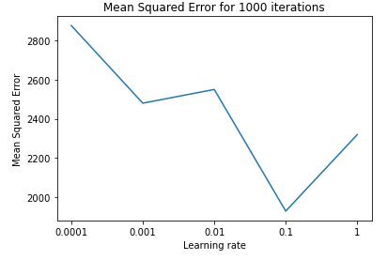
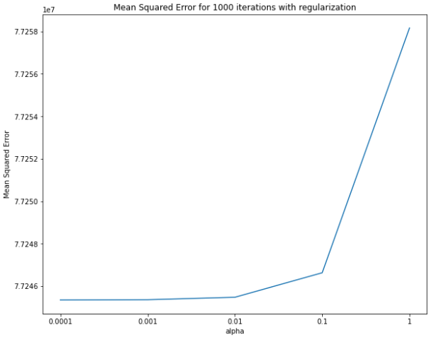
Gradient Descent Efficiency and Findings
We found out that in the first dataset have the lowest MSE (=Mean Squared Error) at the learning rate 0.1
The smaller the alpha value is, the less regularization it has

Slide 17
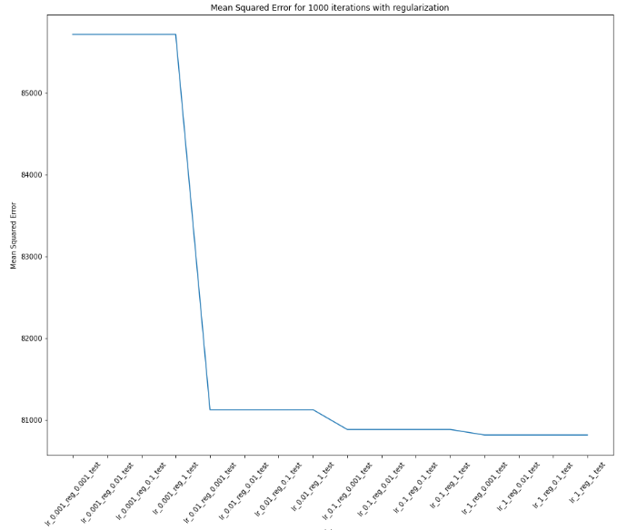
Gradient Descent Efficiency and Findings
We can see that the learning rate has the biggest effect on our algorithm
Performance drops from 0.001 and 0.01

Slide 18
k-NN Algorithm
Lazy learner → doesn’t learn immediately
Non-parametric → does not make assumption on underlying data
Can be used for Classification and Regression
Regression algorithm :
Loop over each point of the test data set to find the distance between the test point and train data points
the distance is computed according to a certain metric
Sort distances and find the k nearest neighbours
Take the average of those values to predict the continuous target

Slide 19
k-NN Algorithm pseudo-code
predict(X_test, metric, k_neighbours) :
metric_function = get_metric_function(metric)
List : y_pred
for row in X_test :
distances = compute_distances(row, metric_function)
sort_dist = sort(distances)
k_nearest = get_k_first(sort_dist, k_neighbours)
pred = mean(k_nearest)
y_pred.add(pred)
return y_pred

Slide 20
k-NN Implementation
We created a class My_KNN with hyper-parameters :
k_neighbours = 5 by default
metric = “euclidean” by default
We implemented 3 metrics : “euclidean”, “manhattan” and “cosine”
The class has the following functions :
fit(X_train, y_train) : save the training set
predict(X_test) : give the predictions on the test set
score(y_pred, y_true) : give the RMSE between the predictions and the true values
best_params(X_test, y_test) : search for the hyper-parameters that give the best score

Slide 21
k-NN vs. others
1. Diamonds data set - Hyper-params - k_neighbors = 7, metric = “euclidean”
Algorithm | MSE | MAE
Decision Tree | 1170.50 | 235.00
AdaBoost | 2968.76 | 2542.24
Gradient Boosting | 1240.35 | 548.99
k-NN | 1135.02 | 281.42
Custom k-NN | 1144.10 | 287.14

Slide 22
k-NN vs. others
2. Airbnb data set - Hyper-params - k_neighbors = 7, metric = “euclidean”
Algorithm | MSE | MAE
Decision Tree | 28.45 | 5.00
AdaBoost | 189.44 | 116.99
Gradient Boosting | 90.14 | 48.85
k-NN | 92.98 | 35.85
Custom k-NN | 93.08 | 36.00

Slide 23
k-NN vs. others
3. FPS data set - Hyper-params - k_neighbors = 7, metric = “euclidean”
Algorithm | MSE | MAE
Decision Tree | 33.25 | 20.00
AdaBoost | 63.35 | 53.44
Gradient Boosting | 35.46 | 24.96
k-NN | 36.87 | 24.28
Custom k-NN | 36.72 | 24.28

Slide 24
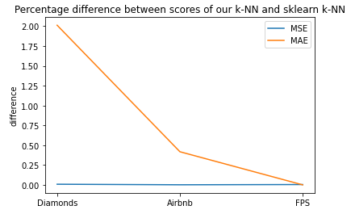
k-NN Efficiency and Findings
Thanks to the previous tables, we can see that the efficiency of our k-NN is really close to the sklearn version :
The MSE differences are almost null and for the MAE (=Mean Absolute Error) we can observe a maximum difference of 2 % for the Diamonds data set.

Slide 25
k-NN Efficiency and Findings
The computation time for our own version of the k-NN is very long compared to sklearn version :
Data sets | Airbnb | Diamonds | FPS
Data set entries | 344 493 | 3 101 982 | 11 497 491
k-NN | 0.0034 | 0.40 | 5.48
Custom k-NN | 0.24 | 4.56 | 59.66
Computation time in minute for each data set
The computation time depends on the size of the data set. Airbnb is the smallest therefore it is the fastest.

Slide 26
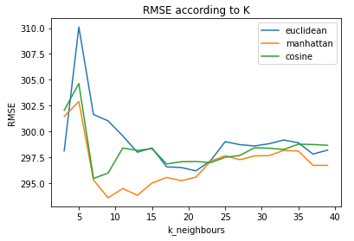
k-NN Other Findings
Because of the computation time of the Airbnb dataset, we searched for its best hyper-parameters by using the function best_params(X_test, y_test) of our k-NN class :
Best hyper-parameters to optimize the RMSE :
best_params = {'metric': 'manhattan',
'k_neighbours': 9}
Best hyper-parameters to optimize the MAE :
best_params = {'metric': 'manhattan',
'k_neighbours': 8}

Slide 27
Conclusion & comments
Overall the algorithms were straightforward to apply
Easily done through lecture notes, online articles and formulas + pseudocode
Even though our algorithms have good MSE and/or MAE results computation times of already existing algorithms and functions were faster due to the fact that they were specifically improved for that
All in all these two algorithms are big staples regression algorithms in machine learning, but due to the fact that these are older approaches (1951 for knn, 1847/1944 for gradient descent), newer approaches might be more attractive to use in machine learning

